Slide 1

Project Title -
Presented By :- Siddhant Rajesh Raut
College :- Institute of management research and development shirpur
AICTE STU ID :- STU6a63a09a3c0861784914074

Slide 2

PROBLEM STATEMENT
Agricultural performance varies across different seasons due to changes in environmental conditions, water availability, irrigation methods and crop characteristics. It is difficult to understand which season, crop or region performs better without analyzing agricultural data.
This project focuses on analyzing agricultural data to identify seasonal patterns and compare yield, production, revenue and profit across different seasons.

Slide 3
Project Description
The Seasonal Agriculture Performance Analysis project is based on Exploratory Data Analysis using Python.
The project analyzes agricultural data containing information about crops, seasons, states, environmental conditions, irrigation methods, yield, production, revenue and profit.
The main objective is to compare the agricultural performance of Kharif, Rabi and Zaid seasons and identify important patterns related to crop productivity and profitability.
This project analyzes agricultural data to understand the performance of different seasons, crops, irrigation methods and states.
The dataset contains 4,000 records and 28 columns, including rainfall, soil moisture, water usage, yield, production, revenue and profit.
Using Python, Pandas, NumPy, Matplotlib and Seaborn, the data is cleaned, analyzed and visualized to identify important patterns and relationships.
The main focus is to compare Kharif, Rabi and Zaid seasons and identify the factors affecting agricultural productivity and profitability.

Slide 4

WHO ARE THE END USERS?
Farmers – To understand crop and seasonal performance.
Agricultural Analysts – To analyze agricultural trends and patterns.
Agricultural Planners – To support planning and decision-making.
Researchers and Students – To study relationships between agricultural variables.
Agribusiness Organizations – To analyze crop profitability and regional performance.

Slide 5

Technology Used
Python – For data analysis.
Pandas – For data manipulation and cleaning.
NumPy – For numerical operations.
Matplotlib – For data visualization.
Seaborn – For statistical and analytical visualizations.
Jupyter Notebook / Google Colab – For executing the analysis.

Slide 6
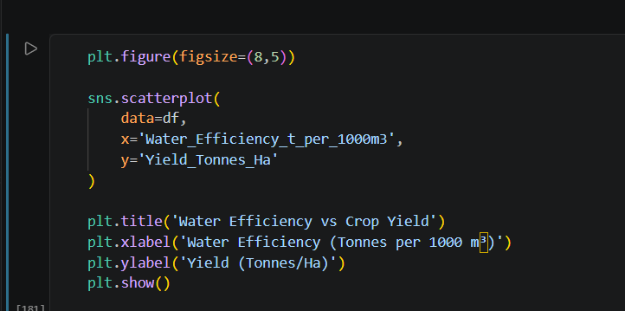
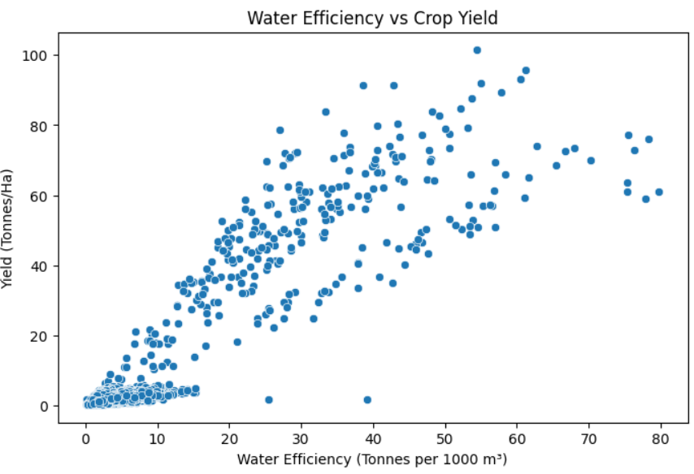
RESULTS

Slide 7
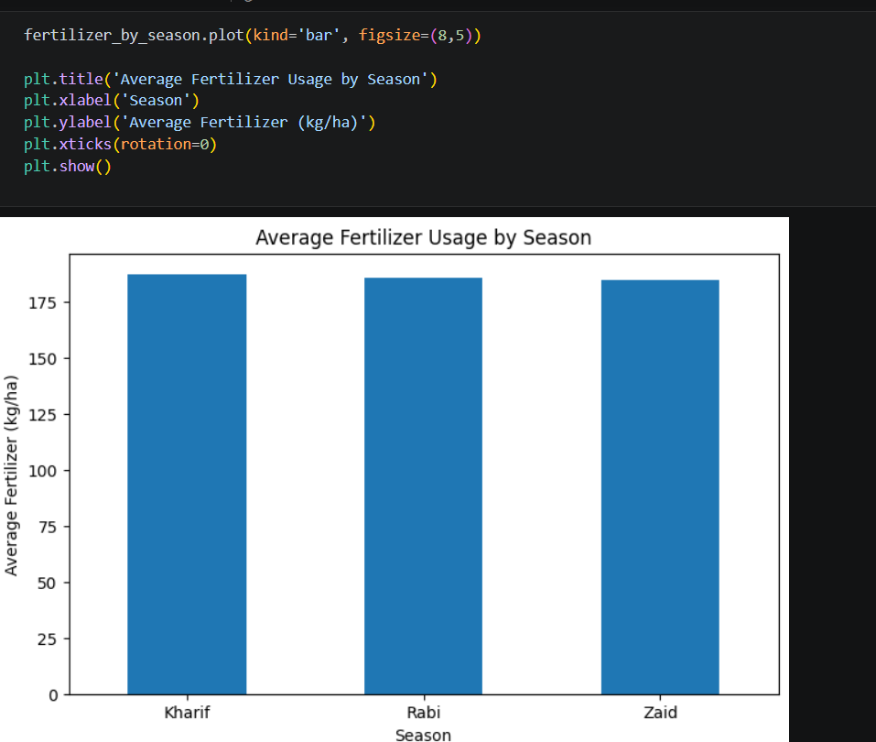
RESULTS

Slide 8
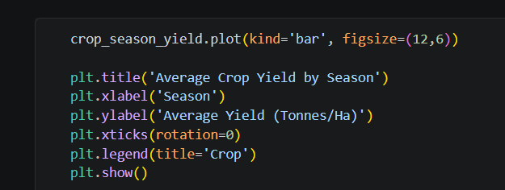
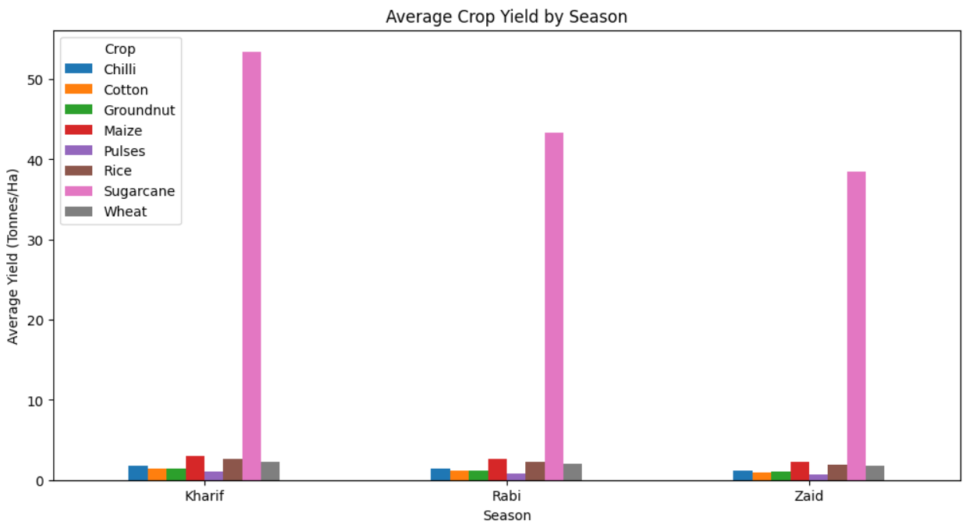
RESULTS

Slide 9
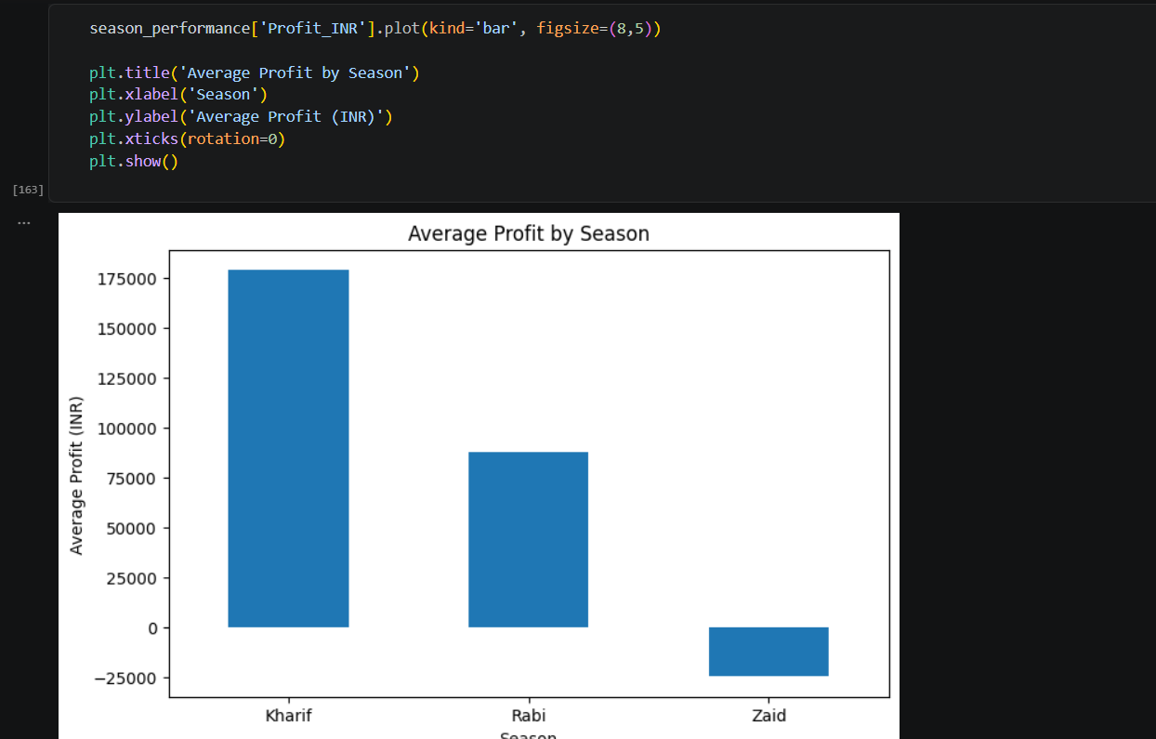
RESULTS

Slide 10
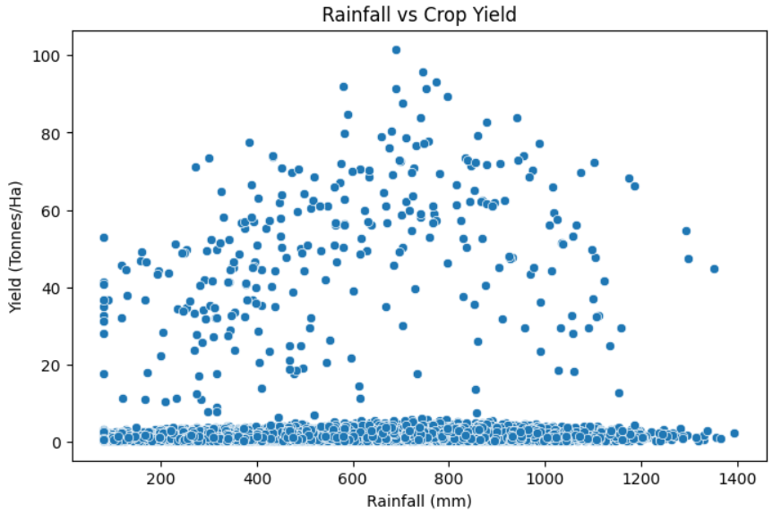
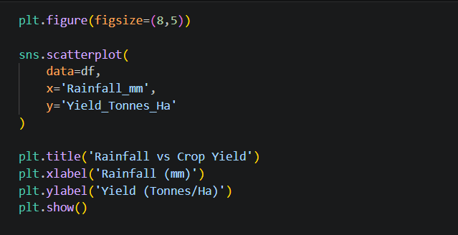
RESULTS

Slide 11
Future scope
Crop Yield Prediction using Machine Learning.
Profit and Revenue Prediction for future seasons.
Add more years of agricultural data for better analysis.
Include weather and market price data.
Develop an interactive agricultural dashboard.
Provide crop and season recommendations based on data analysis.

Slide 12
GitHub Link
https://github.com/siddh17021505/Seasonal-Agricultural-Performance-Analysis.git

Slide 13

VOIS Course completion certificate - Course name- Data Visualization

Slide 14
Thank you
.
.

